Slide 1
Java Collections and Exception Handling
By: Arpit Bhushan Sharma
Mentor ProPeers

Slide 2
Java Collections and Exception Handling
1. Introduction to Java Collections Framework
2. The List Interface
3. The Set Interface
4. The Map Interface
5. The Queue Interface
6. Choosing the Right Data Structure
7. Introduction to Exception Handling
8. Exception Handling in Java
9. Custom Exceptions
10. Hands-on Project: Student Record Manager

Slide 3
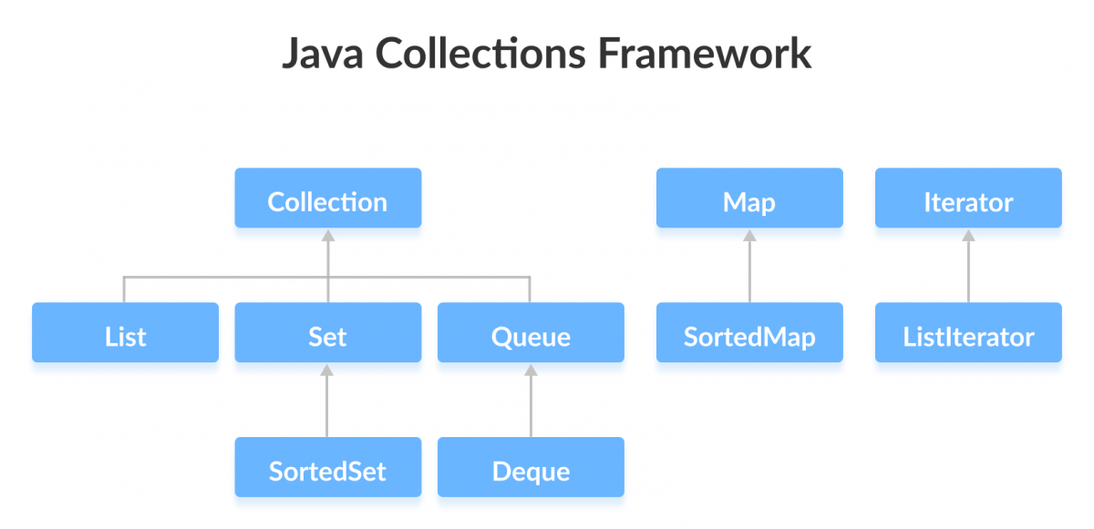
1. Introduction to Java Collections Framework
The Java Collections Framework (JCF) is a set of classes and interfaces providing reusable data structures to store and manipulate groups of objects.
It offers a unified architecture for representing and managing collections efficiently.
Collections are crucial for storing, retrieving, and manipulating data effectively in Java applications.

Slide 4
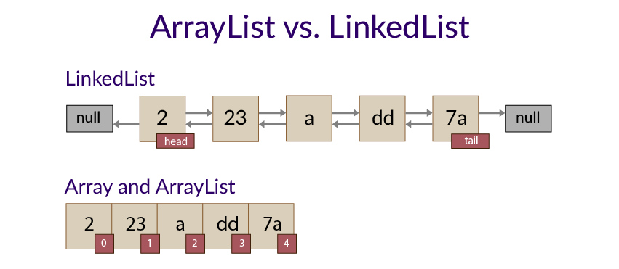
2. The List Interface
The List interface represents an ordered collection (sequence) of elements.
It allows duplicate elements and maintains the insertion order.
ArrayList: Uses a dynamic array; good for quick random access (get), but slower for insertions/deletions in the middle.

Slide 5
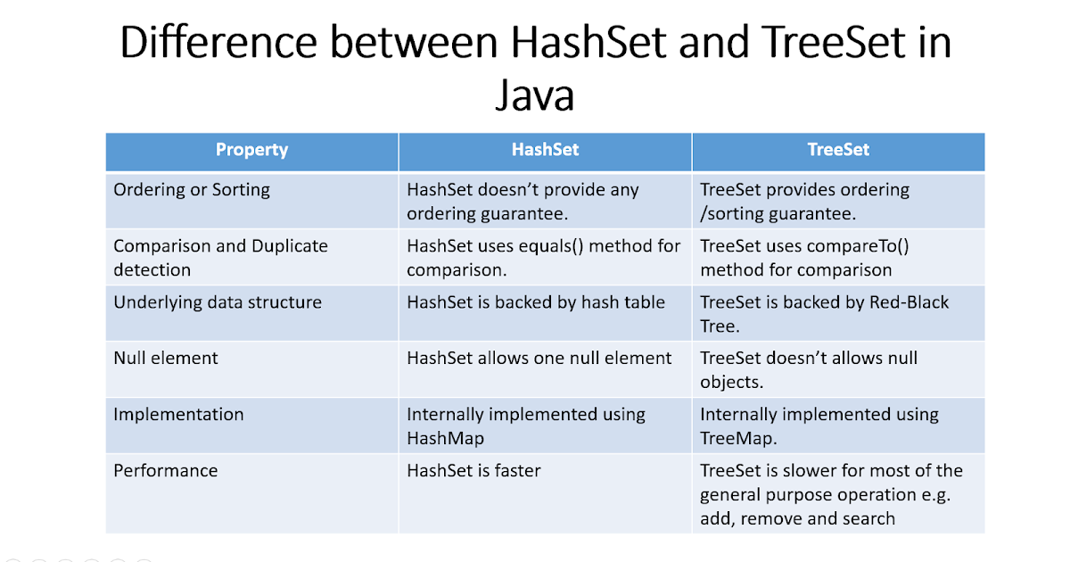
3. The Set Interface
The Set interface represents a collection that does not allow duplicate elements.
It models the mathematical set abstraction.
HashSet: Stores elements using a hash table; offers constant-time performance (O(1)) for basic operations like add, remove, contains. Elements are not ordered.
Type of Set Implementations in JCF:
HashSet
LinkedHashSet
TreeSet
EnumSet
ConcurrentSkipListSet
CopyOnWriteArraySet

Slide 6
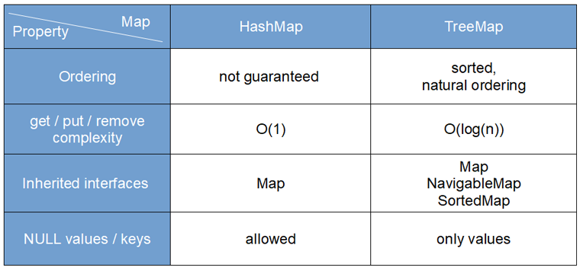
4. The Map Interface
The Map interface represents a collection of key-value pairs.
Each key is unique, and it maps to a single value.
HashMap: Implements the Map interface using a hash table. Does not guarantee any specific order. Generally offers O(1) average time for `put`, `get`, and `containsKey` operations.
Type of Set Implementations in JCF:
IdentityHashMap
WeakHashMap
EnumMap
ConcurrentHashMap
LinkedHashMap
TreeMap
HashMap
HashTable

Slide 7
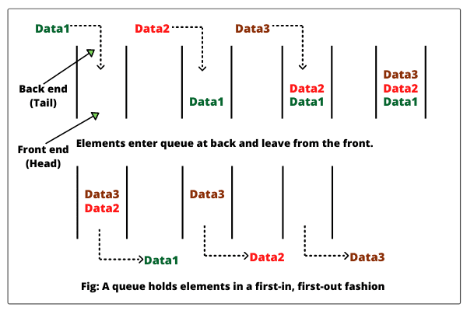
5. The Queue Interface
The Queue interface represents a collection designed for holding elements prior to processing.
It typically follows a First-In, First-Out (FIFO) principle.
LinkedList: Can be used as a Queue in FIFO order.
Similar to Queue we have a Collection:- Stack
It typically follows a Last-In, First-Out (LIFO) principle

Slide 8
Implementation | Thread-Safe | Ordered | Allows null | Notes
LinkedList | ❌ | FIFO | ✅ | Doubly-linked list
PriorityQueue | ❌ | Sorted | ❌ | Based on priority
ArrayDeque | ❌ | FIFO | ❌ | Very fast; better than LinkedList
ConcurrentLinkedQueue | ✅ | FIFO | ✅ | Non-blocking, lock-free
ArrayBlockingQueue | ✅ | FIFO | ❌ | Bounded, blocking
LinkedBlockingQueue | ✅ | FIFO | ❌ | Unbounded unless specified
PriorityBlockingQueue | ✅ | Sorted | ❌ | Thread-safe priority queue

Slide 9
Implementation | Thread-Safe | Allows null | Recommended for | Notes
Stack | ✅ (legacy) | ✅ | Small apps | Legacy, synchronized
ArrayDeque (as Stack) | ❌ | ❌ | Most use-cases | Fast, memory efficient
LinkedList (as Stack) | ❌ | ✅ | Stack+Queue uses | More memory than ArrayDeque
Collections.synchronizedDeque() | ✅ | Depends on base | Thread-safe needs | Use wrapper around deque
Custom Array Stack | ❌ | ❌ | Learning only | Manual resizing needed

Slide 10
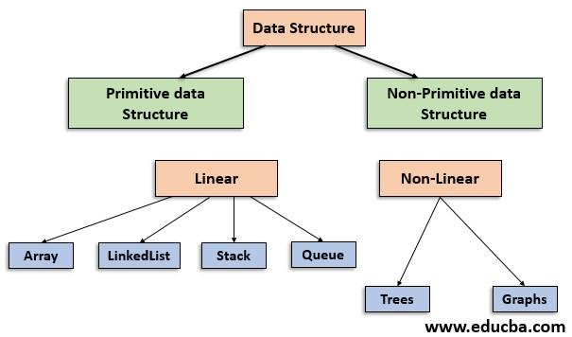
6. Choosing the Right Data Structure
Performance and Efficiency: The choice impacts time complexity (how fast operations run) and space complexity (how much memory is used).
Consider the common operations your application will perform (add, remove, search, iterate, sort) you can think for a right Data Structure.

Slide 11
Data Structure | Real-Life Use Case
Array | Seats in a movie hall (fixed size, indexed access)
ArrayList | Dynamic playlist in a music app (growable array)
LinkedList | Photo gallery navigation (forward/backward), train bogies
Stack | Undo/Redo in text editor, browser back button, plates stack
Queue | Ticket line, printer task queue, call center support queue
Deque (Double-Ended Queue) | Browsing history navigation (back/forward), sliding window in algorithms
PriorityQueue | Hospital emergency room triage, CPU scheduling (shortest job first)
HashMap | Dictionary, contacts list (name → number), cache, config lookup
TreeMap | Sorted contacts (alphabetically), leaderboard (score → player)
HashSet | Unique usernames, email IDs, or pan card numbers
LinkedHashSet | Recently visited pages (maintains insertion order + uniqueness)
TreeSet | Auto-suggestions sorted alphabetically
Graph | Maps (city → city routes), social network connections
Tree (Binary Tree, BST) | Family tree, file/folder hierarchy, decision trees
Trie (Prefix Tree) | Search bar auto-complete, spell checker, IP routing
Heap (Min/Max Heap) | Priority queue, scheduling tasks, finding top N elements
Segment Tree | Range query (sum, min, max) in a stock price list or sensor logs
Fenwick Tree (BIT) | Efficient cumulative frequency or prefix sums
Union-Find (Disjoint Set) | Detecting cycles in a network, social groups, Kruskal’s algorithm
Matrix (2D Array) | Game board (like chess, sudoku), images/pixels, graphs (adjacency matrix)
Circular Queue | Round-robin scheduling, carousel ads, fixed-size buffer
LinkedBlockingQueue | Producer-consumer problems, thread-safe messaging queues
ConcurrentHashMap | Multi-threaded caching, shared session storage

Slide 12
7. Introduction to Exception Handling
What are Exceptions? An exception is an unexpected event that occurs during the execution of a program, disrupting its normal flow.
It indicates a problem that the program should handle to prevent abrupt termination.

Slide 13
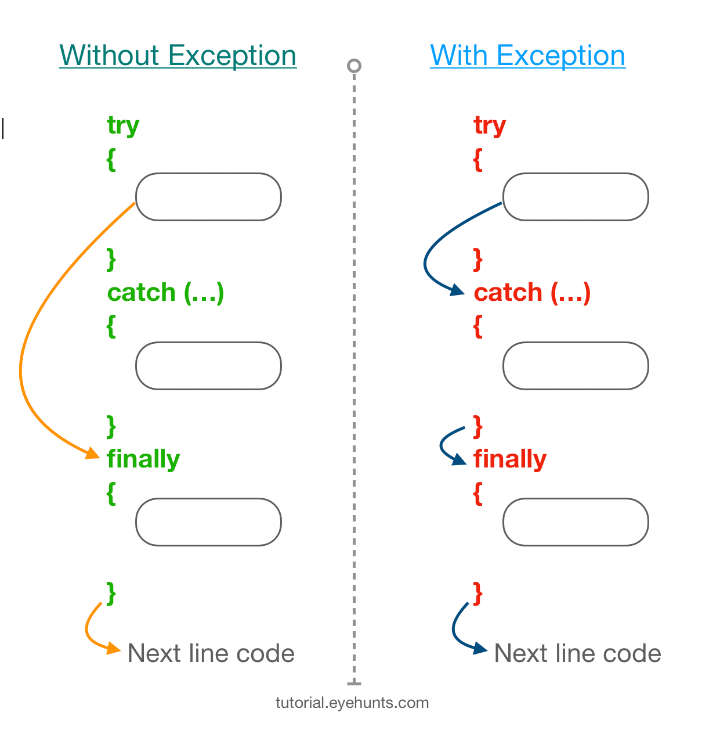
8. Exception Handling in Java
Try-Catch Blocks: The `try` block encloses code that might throw an exception. The `catch` block handles the exception if one occurs.
Use of `throw` and `throws`:
- `throw`: Used to explicitly throw an exception object from within a method or block of code.
- `throws`: Used in a method signature to declare that the method might throw one or more exceptions.

Slide 14
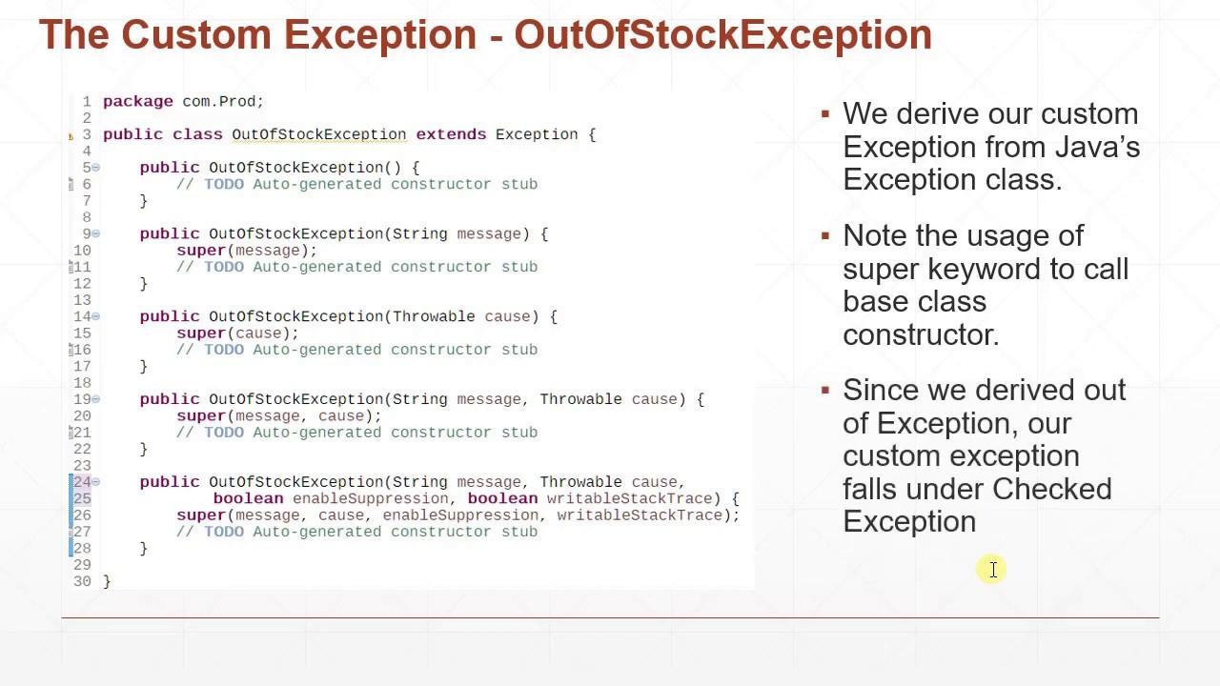
9. Custom Exceptions
Need for Custom Exceptions: Sometimes, built-in Java exceptions don't adequately describe a specific problem in your application. Custom exceptions provide more meaningful and specific error handling relevant to your domain logic.
How to create and use them:
- Create a new class that extends `Exception` (for checked exceptions) or `RuntimeException` (for unchecked exceptions).

Slide 15
10. Hands-on Project: Student Record Manager
Overview of Project Goals: Develop a simple application to manage student records, demonstrating the use of Java Collections and Exception Handling.
Use of `ArrayList` to store student data: An `ArrayList<Student>` can be used to maintain a list of `Student` objects, allowing easy addition and retrieval by index.
Use of `HashMap` for fast lookup: A `HashMap<String, Student>` can store student records where the student ID (String) is the key and the `Student` object is the value, enabling quick retrieval of student data by ID.

Slide 16
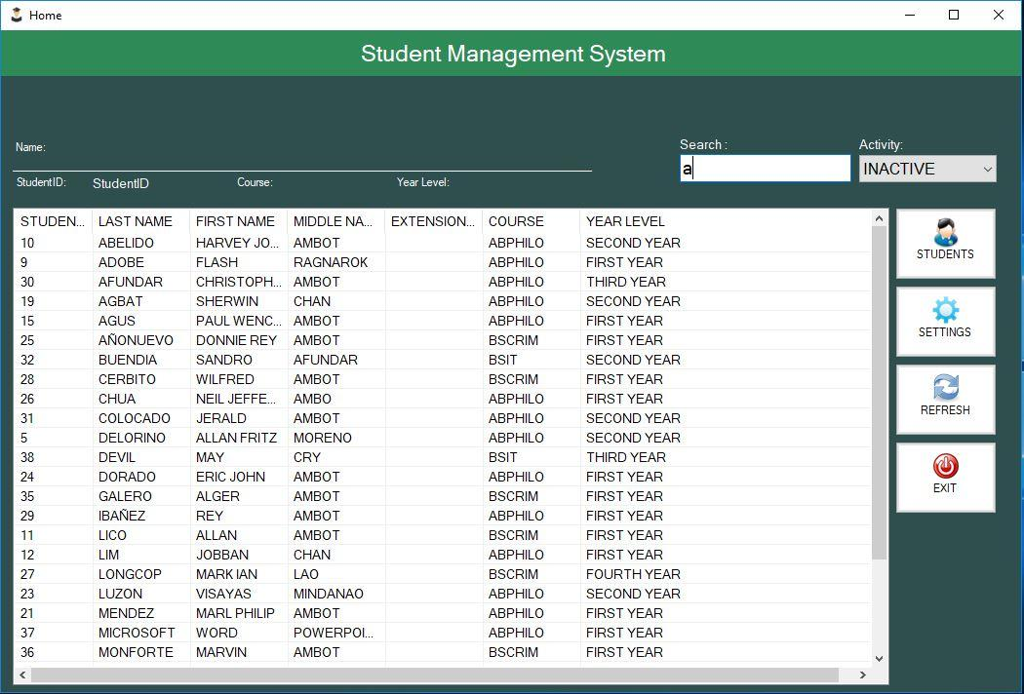
11. Enhancements to the Project
Implement Sorting: Allow sorting of student records by name (alphabetically) or by marks (ascending/descending) using `Collections.sort()` with `Comparator` or by making `Student` comparable.
Add Search Functionality: Implement methods to search for students by ID or name, leveraging the appropriate collection (e.g., `HashMap` for ID lookup, iterating `ArrayList` for name search).
Handle User Input Exceptions Gracefully: Use `try-catch` blocks to validate user input (e.g., `NumberFormatException` for non-numeric input when expecting an integer, `InputMismatchException` for wrong data type). Provide informative error messages and guide the user.

Slide 17
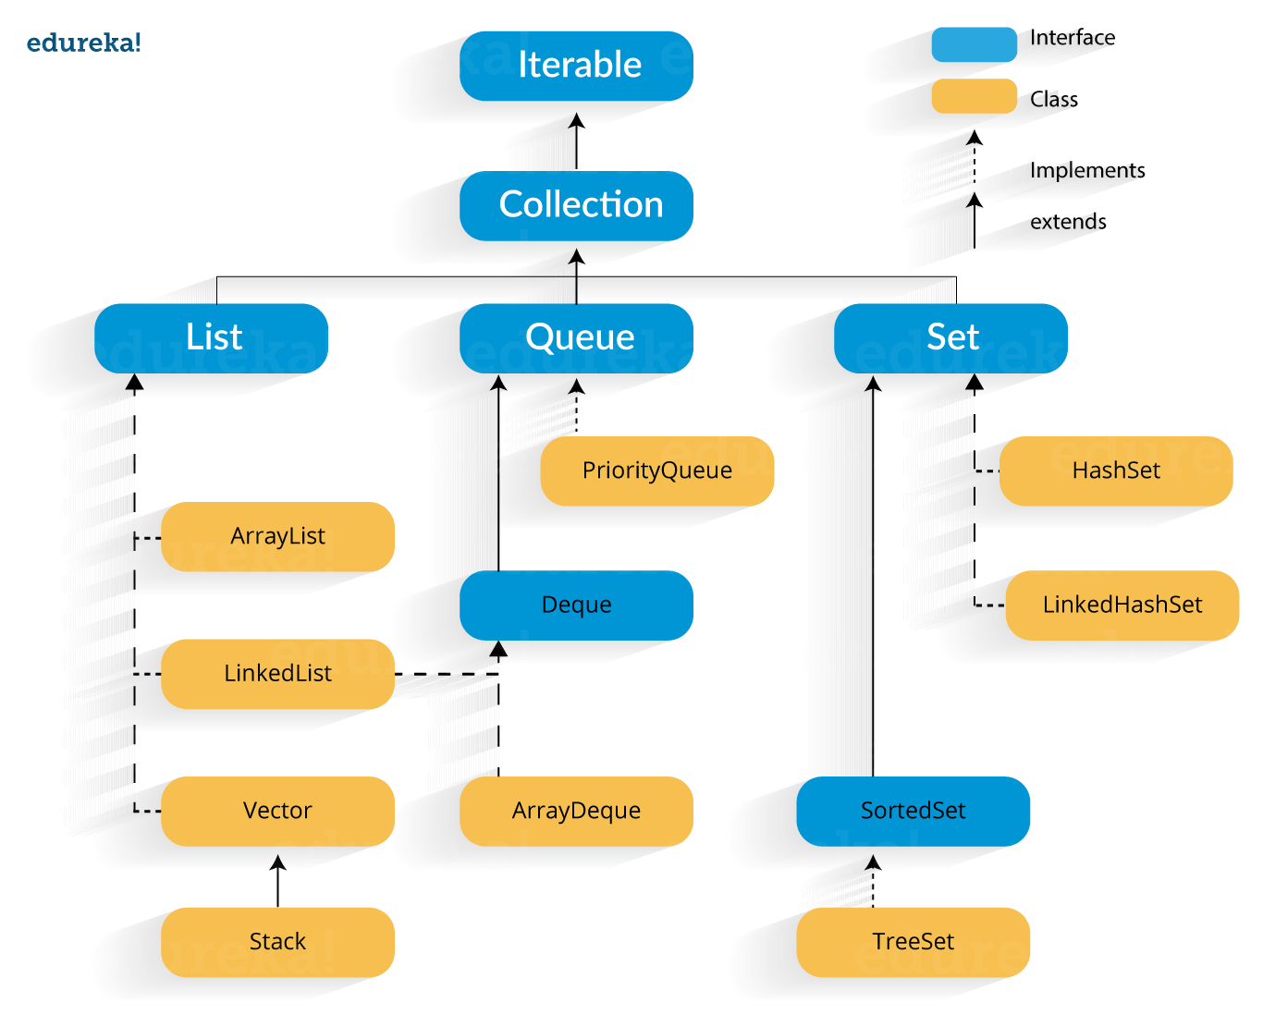
12. Summary and Assignment
Recap Key Concepts:
- Java Collections Framework provides powerful data structures (List, Set, Map, Queue) for efficient data management.
- Exception Handling is vital for building robust and reliable applications.

Slide 18

This Photo by Unknown Author is licensed under CC BY-NC

Slide 19


